Slide 1
Communication Patterns
General Presentation: Part 03

Slide 2
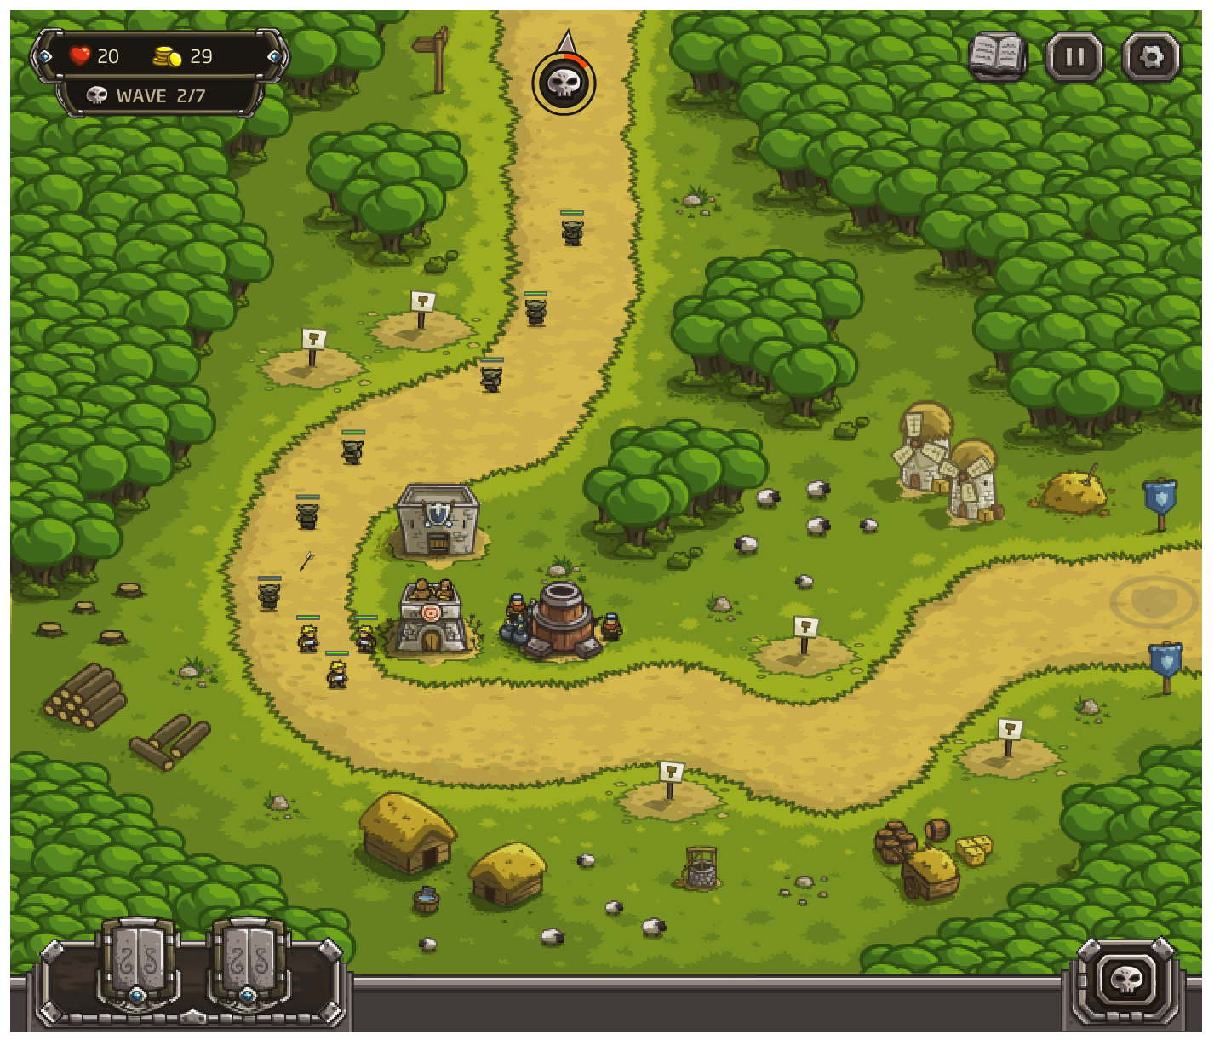
Looking at a TD game
Armour Games: Kingdom Rush
Health and Loot want to know when mobs get to the end or… don’t make it that far
Mobs will walk until they reach the end point
Towers want to know when a monster is near so they can attack the mobs

Slide 3
Communication Patterns
Much of gameplay code is observing game state updates and reacting
From entities to entities “a tower noticed a mob getting near”
From entities to systems “all mobs killed, gold earned, level cleared”
From systems to systems “Level cleared, new location unlocked + ???”
From systems to entities “When the level is clear, all units do a victory dance”
UI is a pervasive “uber-system”
The internal state of other game 'systems' are usually reflected in the UI
Player actions in the UI usually affect other game systems

Slide 4
Example
How do we implement: "a tower noticed a monster getting near?"
Options:
Towers check distance to all entities each frame
Mobs tell other entities “I am at (x,y)”
Higher-level optimized system for distance checks that is monitored by the towers and mobs
No perfect answer, all have trade offs
Notes:
Make an activity here

Slide 5
Communication Patterns
Goal: Decouple senders and receivers
Senders shouldn’t know who they need to inform
Two common ways
Observer pattern
Event Bus pattern
Notice this hooks into the MVC pattern from before

Slide 6

Observer
http://gameprogrammingpatterns.com/observer.html

Slide 7
Observer Pattern
public class Player{
public int Level {get; private set}
public event Action OnLevelUpdate;
public void UpdateLevel (int newLevel){ this.level = newLevel; OnLevelUpdate(); } }
public class UIManager{
public void InitializeUI () { var player = … / get a ref player.OnLevelUpdate += UpdateUI; }
private void UpdateUI () { var player = … // get a reference int newLevel = player.Level; } }
UpdateLevel()
Player
Event callback
UIManager
Other Listeners
Other Listeners

Slide 8
Observer Pattern
Observer Each Observer needs to:
Find a potential sender
Subscribe (and unsubscribe) to updates
Best for: System → Entities updates E.g. level finished -> all entities run away System → System updates E.g. Player score increment -> UI Update

Slide 9
Another way to think about this…
Think about Achievements
How does the game know that something has happened?
Do we check in every method?

Slide 10

From: Game Programming Patterns
Achievement Unlocked: Fell Off Bridge
Do we calculate this every time a call to the physics engine is made?
NO!
Instead we announce when we start calculating a fall
Anything that needs to know is listening for the event
Things like the Achievement Observer
Or perhaps something that plays a falling sound

Slide 11
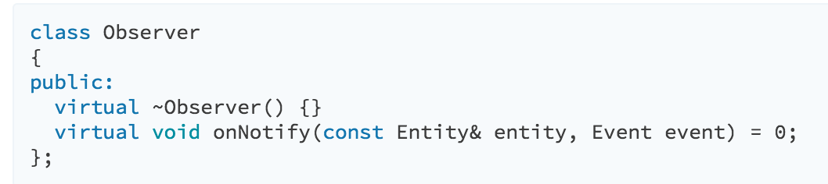
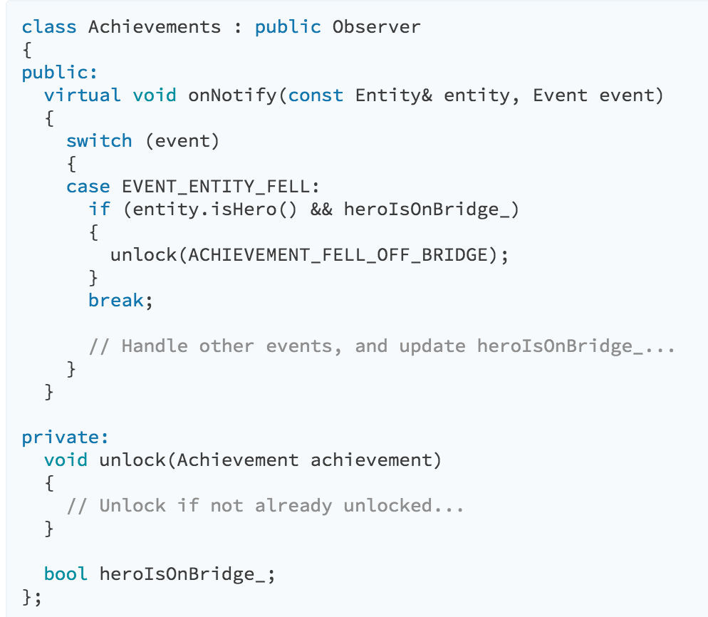
Implementation
Once the virtual class is implemented we have an Observer
In this case the subject performing the action is the one being observed.
Our main goal here is to ensure that nothing depends on anything else being present
The Subject communicates with the observer but isn't coupled, either one could go away and nothing would break
The same is true for multiple observers

Slide 12
Not one but a LIST
We need multiple observers for a simple reason:
What happens if we get the 'fell of bridge' achievement and the sound was connected to the same observer?
We need an observer for each event.

Slide 13
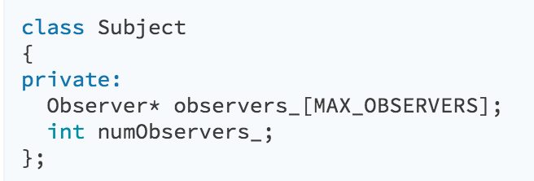
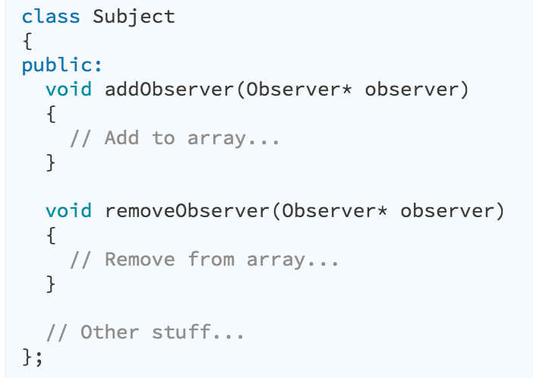
Subject
The subject being observed is responsible for notifications
More importantly it exposes a public API for modifying the list of observers.
The subject controls who gets notifications but isn't coupled to them.
Since there is a list, observers can be added and removed, as necessary.
So when the achievement is met, that observer goes away, but the sound effect one stays in place.

Slide 14
Who Controls the List?
The 'Subject' is responsible for the list of observers
In this case the subject is likely the player object
The 'Subject' has one more task: Notifying the observers
Or do they?

Slide 15
What if…
Each observer was connected to the next?
Linked in some form of list… that is linked together...
Then each observer would be responsible for notifying the next in line…

Slide 16
Final Thoughts
There are some common arguments against this pattern:
It is too slow
What if things get bogged down?
It is too fast
Since the subject pauses until observers are complete things can get out of whack.
What happens when an observer or subject is destroyed?
Implement some form of handler for this. If an observer is removed, and a subject has a pointer to that memory location you're gonna have a bad time.
If subject is trashed make a call to 'removeObserver()' in the destructor and give the Observer the tools needed to handle that.
having control over the destructor is one reason why c++ is SO common in games
Even better: make your base observer class deregester from everything when it is destroyed. Done.

Slide 17
Lapsed Listener Problem
I lied about final thoughts
If an observer fails to deregister when it no longer needs to listen it will keep the subject from being GCd
It will also keep anything that references that subject from being GCd
It will likely do this until the end of the program
Which may come sooner than you'd like if too much memory is leaked…

Slide 18
Event Bus AKA Event Queue

Slide 19
Event Bus / Command Pattern
Game Event
public class GameEvent { // some fields: event type ID, ref to sender, etc }
Public class GameEventBus : MonoBehaviour {
private Queue<GameEvent> _events; public event Action<GameEvent> OnGameEvent;
Public void AddEvent (... event data) { While (_evemts.Count > 0) { GameEvent evt = _event.Dequeue(); OnGameEvent(evt); } } }
Game Event
…
Game Event
Entity
Entity
Entity
On update(), send all events to all subscribers

Slide 20

Observer
Event Bus
Observer Each observer needs to:
Find potential sender
Subscribe (and unsubscribe) to updates
Best for:
Systems → systems
E.g. player score increment
Systems → Entities
E.g. Level finished → all Entities run away
Event Bus One global bus for everyone to subscribe to
Each event goes to all subscribers
Optimization: different busses for different events
Best for:
Entities → Entities
E.g. Player dies → All mobs do a happy dance
Entities → Systems
E.g. Mobs die → player score increment

Slide 21
Event Queue / Event Bus
Every time a user does anything with our program an 'event' is generated
Think about what happens when we type…

Slide 22
Keyboard buffer
When I press the letter 'a' on my keyboard, whatever signal that generates, and the signal generated by all the rest, goes in a buffer.
Each keypress has to be parsed before the next one.
The computer does this REALLY fast.
It used to not be that way though…

Slide 23

Central Event Bus
Most games aren't event driven
What I mean is the game doesn't pause until the player does something
It is common to have a game specific queue
'central', 'global', or 'main' queue are all common
It is used when we want to decouple something in TIME.

Slide 24
Decoupled From Time
Essentially this just means we can put something in a queue and let the system sort it out when it can
Suppose the hero just solved her first puzzle, several things are about to happen:
A boat load of enemies are going to spawn
Loot is going to spawn
A new perk point is going to be applied
And a tutorial window explaining combat is going to appear

Slide 25



Event Queue
Enemies Spawn
Loot!
None of these events rely on one another.
Each is rather complicated
Each can have its own handler
So queue them all and let the game loop sort them out.
Perks!
Tutorial

Slide 26
Other Options
Event Queue is a complex, potentially dangerous, idea.
It stores requests in a global variable that is out of the control of the sender
Event bus decouples the sender from the receiver both statically and in time.

Slide 27
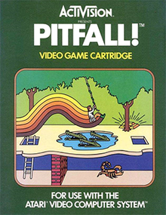

MOAR pitfalls
Assume a game like Tetris, Bejeweled, or Super Puzzle Fighter II Turbo
Suppose there is a bonus if certain gems are cleared when the screen is full
The state of the game will be different when the queue is processed…
Clear Green Gems (checkScreen())
Clear Blue Gems
(checkScreen())
Clear Yellow Gems
(checkScreen())

Slide 28
Data Heavy Events
If the state of the world matters to the event, then the event needs to record the state of the world
This means our events can get large… and therefore slow
Not really a problem so much as a thing to keep in mind.

Slide 29
What about…
If process A sends an event that process B is looking for...
Process B responds and sends an event that A is interested in…
A then responds with the event that B is interested in…
GOTO 1

Slide 30
FIFO for the WIN
First in, first out should address the infinite loop problem

Slide 31
Quick Aside
The author talks about a 'Ring Buffer' Does anyone know what this is?

Slide 32
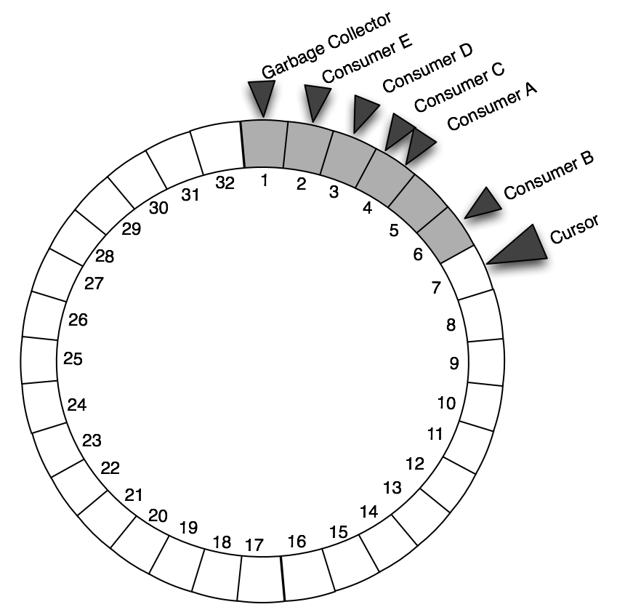
Quick Aside
The author talks about a 'Ring Buffer' Does anyone know what this is?

Slide 33
Merging requests for great power
By queueing our requests we can check to see if there are things that can be batched.
Notably AUDIO.
Anyone know what happens when two exact waveforms are played simultaneously?
Anyone play Metal Slug?

Slide 34
What Goes in the Queue?
Queue Events / Notifications if:
You will have multiple listeners looking at events and time isn't much of an issue
Broad scope for the queue with lots of listeners
Queue Messages / Requests if:
We want something to happen in the future
Likely we will have a single listener

Slide 35

Types of Queue

Slide 36
Who Can Read from the Queue? Single-Cast Queue
When the Queue is part of the readers API.
The queue becomes an implementation detail of the reader
The queue is more encapsulated
No Worries about contention between listeners

Slide 37
Who Can Read from the Queue? Broadcast Queue
Most event systems are Broadcast Queues
All listeners see all events
This is networking in a nutshell
If there are no listeners, the event is dropped
Events may need to be filtered
Lots of events == lots of listeners which can take up resources
Listeners can be designed to filter events they receive
Such as only mouse input

Slide 38
Who Can Read from the Queue? Work Queue
Like a broadcast queue except an item goes to only one of the listeners attached to the queue
The queue needs logic to figure out which listener to contact
Round robin, random, or something more complex

Slide 39
Who Can Write to the Queue?
One Writer
This is basically synchronous observer
It is implicitly known where the event originates, since there is only one sender.
We need multiple readers or this is just a vanilla queue data structure

Slide 40
Who Can Write to the Queue?
Multiple Writers
Any part of the codebase can write to the queue
Be careful of cycles,
since anything can write to the queue a process might get interrupted and then have to start writing again…
Probably want to reference the sender in the event to ensure the results are delivered appropriatly.

Slide 41
What is the lifetime of objects in the queue?
In a GCd language don't stress over this. The event will live in memory as long as it is needed. In C or C++ however…
Pass Ownership
This is the traditional method when manually managing memory
Queue claims the message until the receiver takes ownership
Sender → Queue → Receiver
Then the receiver deallocates the object when it is done with it.
Probably a good idea to implement some kind of time out…

Slide 42
Lifetime of the objects in the queue
Share Ownership
Message sticks around as long as something needs it.
Basically let the GC handle it.
You could also implement smart pointers with reference counts but that is getting silly…

Slide 43
Lifetime of the objects in the queue
The Queue Owns it.
Events are objects that the queue creates
Sender requests a 'fresh' event from the queue
The queue returns a reference to a message/Event object and the sender writes to it.
The receiver references the same object in memory.

Slide 44
Thoughts on Queues and Threads
A handy way to take advantage of multi-core && multi-thread processors is to have a queue for different operations and assign each to a queue
1 core: audio
1 core: rendering
1 core: keeping track of mods
And each one gets a queue.

Slide 45
Part 03: Communication Patterns Summary
Observing game state updates and reacting to them:
Many different kinds of senders/receivers: Event Bus Queue
From entities to entities
From entities to systems
few senders / few receivers: observer
From systems to systems
From systems to entities

Slide 46
More info
Read this: http://gameprogrammingpatterns.com/observer.html
And This: http://gameprogrammingpatterns.com/event-queue.html
and this: https://sourcemaking.com/design_patterns/observer

